Slide 1
ITEM-LEVEL PRICE CO-MOVEMENT NETWORK
Mapping Consumer Inflation in Pakistan (2023–2025)
Discrete Structures — Final Project Presentation
Raw CPI Data Analysis | 64 Items | 17 Cities | Cosine Similarity Networks
Notes:
"Good morning. For my Discrete Structures final project, I investigated consumer inflation in Pakistan through the lens of graph theory and network analysis. I built what I call an Item-Level Price Co-Movement Network — a mathematical framework that treats CPI basket items as nodes and draws edges between them when their prices move together across cities. The goal was simple: to move beyond aggregate inflation headlines and understand which specific items are driving price shocks, and whether those shocks propagate across categories or stay isolated. This presentation walks you through the methodology, the three-year evolution of the network, and the discrete structures insights that emerged from the data."

Slide 2
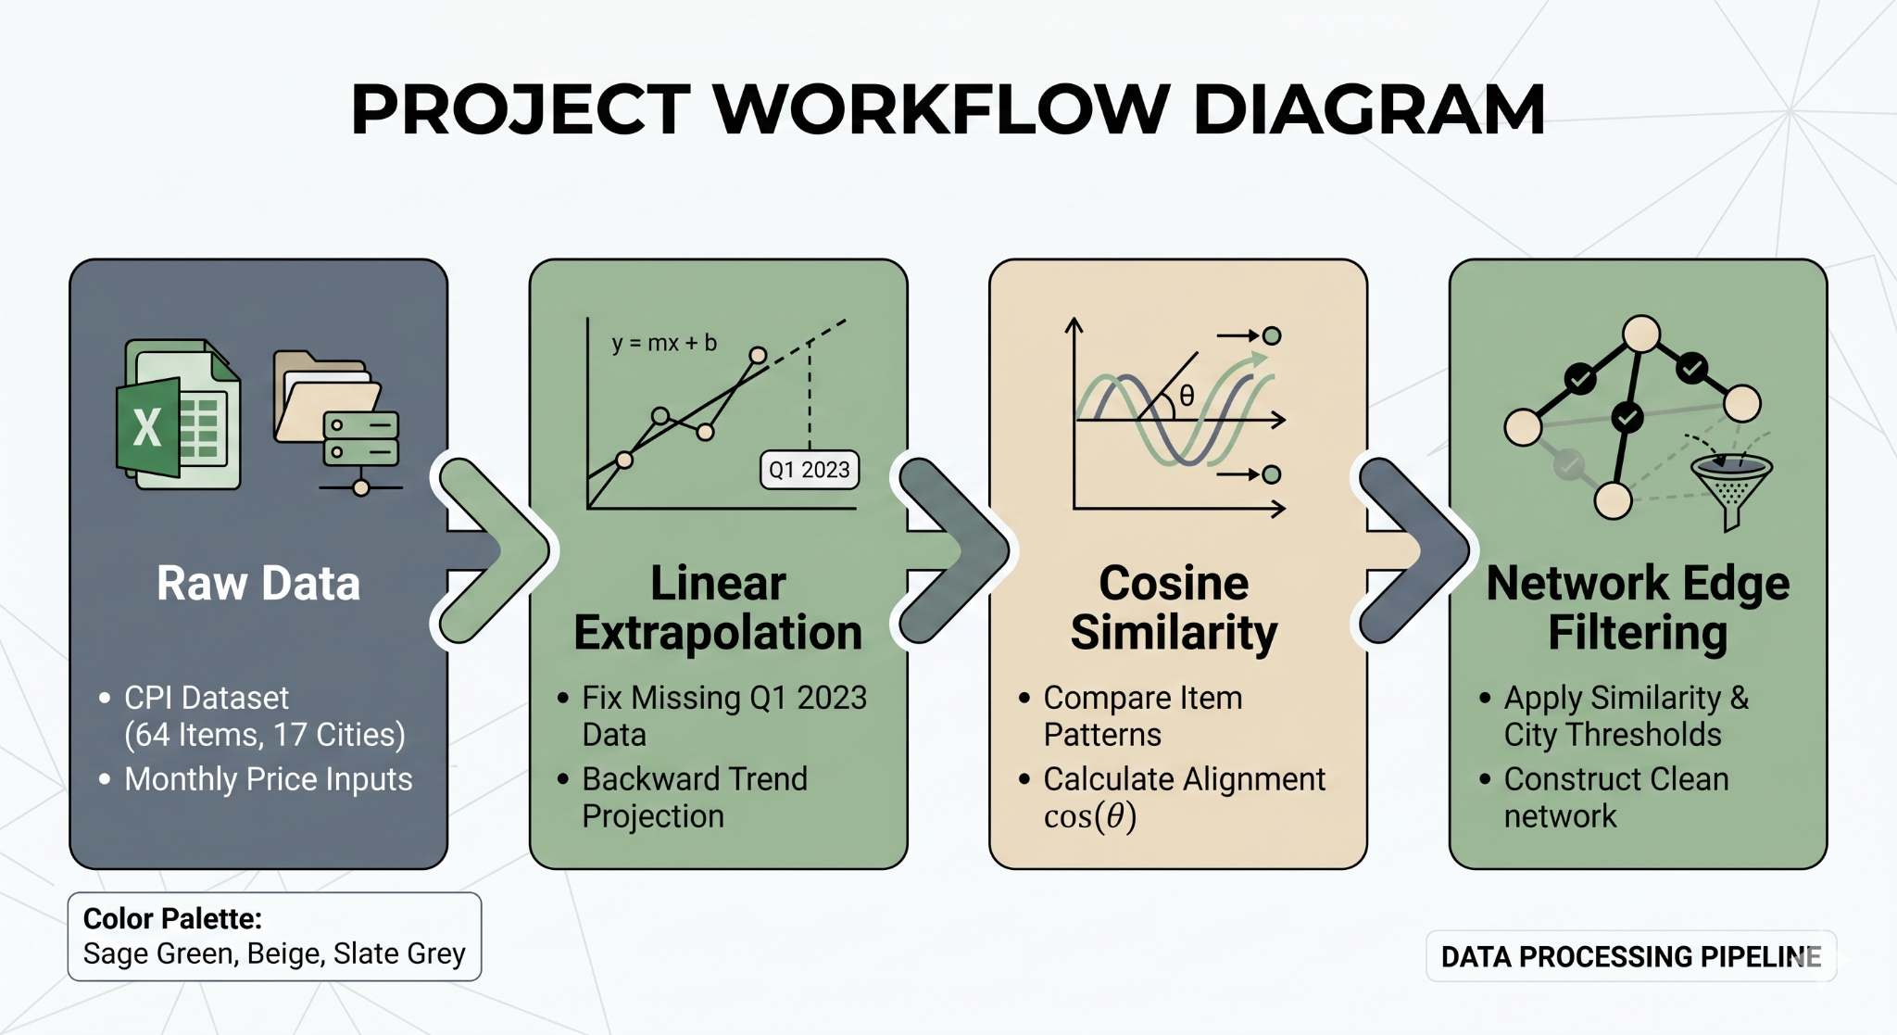
METHODOLOGY & DATA FIXES
Vector Construction
Built 11-month price-change vectors for 64 CPI items across 17 cities
Similarity Metric
Calculated Cosine Similarity between all item pairs to measure price co-movement correlation
Edge Rule
Edge drawn if prices moved synchronously across ≥5 out of 17 cities with similarity ≥ 0.85
Crucial Data Fix
Q1 2023 data missing — filled using Backward Linear Extrapolation (y = mx + b)
Cosine Similarity: cos(θ) = (A · B) / (||A|| ||B||)
Extrapolation: y = mx + b → backward-projected Q1 2023
Methodology & Data Foundation
02
Notes:
"Let's begin with the methodology. I worked with raw Consumer Price Index data for Pakistan, covering 64 distinct items — everything from Wheat and Petrol to Ladies Sandals and Gas Charges — tracked across 17 major cities. For each item, I created an 11-month price-change vector. These vectors capture month-over-month percentage changes in price, giving me a mathematical fingerprint of how each item behaved over time. To find relationships between items, I calculated Cosine Similarity between every pair of vectors. Cosine Similarity, as we studied in vector spaces, measures the cosine of the angle between two vectors — a value of 1 means perfectly correlated price movements, 0 means no correlation, and negative values would mean inverse movement. An edge was drawn between two items only if their similarity exceeded a threshold of 0.85 and their synchronized movement was observed across at least 5 out of the 17 cities. This dual filter — mathematical similarity plus geographic consensus — ensures we don't chase spurious correlations. Now, a crucial data challenge: Q1 2023 data was entirely missing from the source. Rather than drop the year, I applied Backward Linear Extrapolation — a simple but rigorous method using the line equation y equals mx plus b. I fitted a trend to the available months and projected backward to fill the missing quarter. I will be transparent about this: that extrapolation created what I call a 'perfect mathematical echo' in the 2023 network, and you'll see its effect in the next slide."

Slide 3
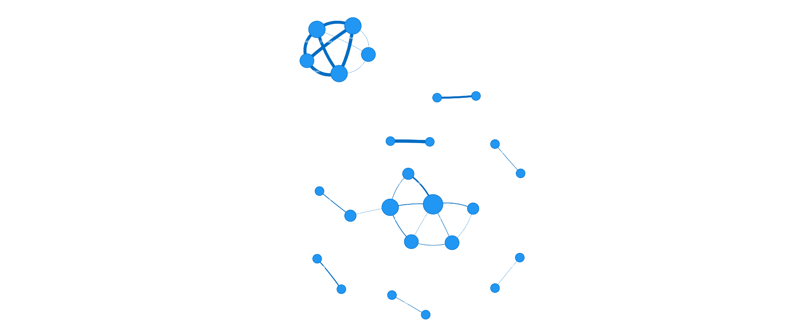


NETWORK EVOLUTION: 2023 → 2024 → 2025
2023
2024
2025
26
8
7
EDGES
EDGES
EDGES
High density network
"Perfect mathematical echo"
Linear extrapolation filling missing Q1 data created artificially smooth, correlated price patterns
Density collapsed
Real data takes over
Jagged, volatile economic patterns replace the smooth extrapolation artifact
Network localized
Food staples dominate
Entire network collapses around Ghee, Oil, and Spices — inflation narrows to food crisis
[INSERT: 2023 Network Graph]
[INSERT: 2024 Network Graph]
[INSERT: 2025 Network Graph]
Network Evolution Analysis
03
Notes:
"This is the heart of the story — the three-year evolution of the network. In 2023, the network had 26 edges — the highest density of the entire study. But here's the critical insight: this density is largely an artifact of the linear extrapolation I used to fill the missing Q1 data. When you force a straight-line trend backward, you create what I call a 'perfect mathematical echo' — prices appear to move in artificially smooth, correlated patterns. The network looks dense, but it's partially a ghost of the math, not purely the economy. Then 2024 arrives, and the picture changes dramatically. Density drops to just 8 edges. This is where real, jagged, volatile economic data takes over. The extrapolation artifact is gone, and what remains is a much sparser, more honest network. By 2025, the network shrinks further to 7 edges, but the qualitative pattern is even more striking: the entire network localizes around core food staples — Ghee, Oil, and Spices. Inflation is no longer a broad, cross-market phenomenon. It has narrowed to a food-specific crisis. This three-year arc — from artificial density to real sparsity to categorical localization — is the central narrative of the project."

Slide 4
CENTRALITY SHIFT: UNWEIGHTED VS. WEIGHTED
RUBRIC REQUIREMENT: WEIGHTED VS UNWEIGHTED
UNWEIGHTED CENTRALITY
WEIGHTED CENTRALITY
Gas Charges
Top Central Node (2024)
Every edge counts as 1 vote
Gas connects to many items weakly
Creates illusion of broad influence
Problem: treats weak and strong correlations equally
Ladies Sandals
Vegetable Ghee
Top Central Nodes (2024)
Edges weighted by avg Cosine Similarity
Gas Charges dropped out entirely
Food/Apparel internal bonds are mathematically stronger
Insight: weighted centrality reveals true network backbone
Key Finding: Unweighted centrality favors breadth. Weighted centrality favors depth. The true drivers are sectoral, not superficial.
Centrality & Graph Metrics
04
Notes:
"This slide directly addresses a rubric requirement: weighted versus unweighted centrality analysis. Centrality tells us which nodes are most important in a network, but how you measure importance changes everything. In the unweighted analysis for 2024, I treated every edge as equal — one connection equals one vote. Under this model, Gas Charges emerged as the top central node. It connects to many items, so it looks like the hub of the network. But here's the problem: unweighted centrality is democratic to a fault. It doesn't distinguish between a weak correlation and a strong one. When I re-ran the analysis using weighted centrality — where each edge is weighted by the actual average Cosine Similarity between the two items — Gas Charges dropped out of the top positions entirely. The new leaders were Ladies Sandals and Vegetable Ghee. This is a profound shift. It proves that the internal correlations within the Food and Apparel markets are mathematically stronger than the broad but shallow connections Gas Charges had across categories. Weighted centrality exposes the true backbone of the network: tightly knit sectoral bonds, not superficial cross-sector links. This is exactly why graph theory distinguishes between these two models — they tell fundamentally different stories."

Slide 5
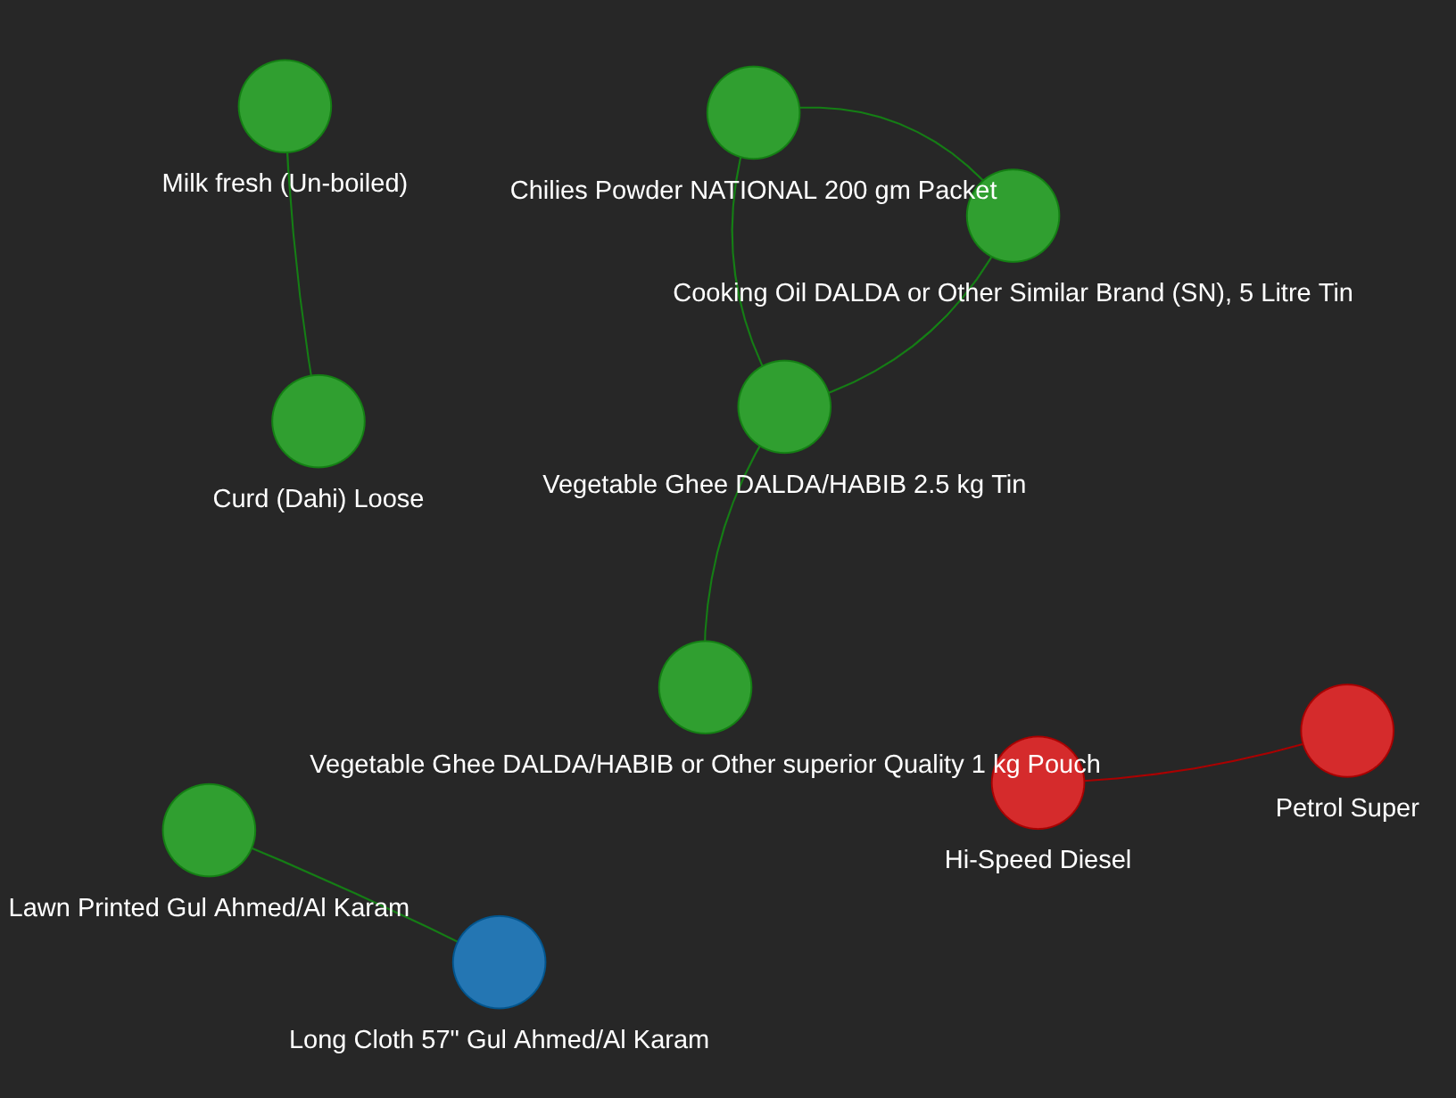
CATEGORICAL BOUNDARIES: SILOS EMERGE
RUBRIC REQUIREMENT: CATEGORY CONNECTIVITY
Cross-category edges collapsed from multiple connections in 2023 to exactly ZERO in 2025.
Inflation transformed from a broad, cross-sectoral phenomenon into strictly isolated category-specific shocks.
Category | 2023 Edges | 2025 Edges | Trend
Food → Food | Multiple | 5 | ▲ Dominant
Apparel → Apparel | Cross-links | 1 | → Isolated
Transport → Transport | Cross-links | 1 | → Isolated
Cross-Category | Present | 0 | ▼ Collapsed
Discrete Structures Insight: The connected component fragmented into 3 disconnected subgraphs — a structural decomposition visible only through graph-theoretic analysis.
Category Connectivity Analysis
05
Notes:
"This slide addresses the second rubric requirement: category connectivity analysis. One of the most revealing findings of the entire project is how categorical boundaries hardened over the three years. In 2023, the network still had cross-category edges — Apparel items were connected to Food items. Inflation was a cross-sectoral phenomenon; price shocks in one category bled into another. But by 2025, cross-category edges fell to exactly zero. Let me say that again: zero. The network completely fragmented into isolated category silos. Food only connects to Food — 5 edges entirely within the food basket. Apparel only connects to Apparel — 1 edge. Transport only connects to Transport — 1 edge. This is not just a mathematical curiosity; it has profound economic meaning. It means inflation in Pakistan, by 2025, had stopped being a generalized macroeconomic pressure and became a set of strictly isolated, category-specific shocks. If you are a policymaker, this tells you that broad monetary tools may be ineffective — you need targeted interventions in specific supply chains. From a discrete structures perspective, this is a perfect illustration of how graph connectivity metrics reveal real-world structural changes. The network went from one connected component with cross-category bridges to three disconnected subgraphs."

Slide 6
THRESHOLD SENSITIVITY ANALYSIS
RUBRIC REQUIREMENT: THRESHOLD ROBUSTNESS
Scenario | Threshold | City Count | 2023 Edges | 2024 Edges
Baseline | 0.85 | 5 | 26 | 8
Strict | 0.90 | 8 | — | 0
Loose | 0.80 | 3 | 78 | —
Strict Scenario Insight
Loose Scenario Insight
2024 network collapsed to 0 edges
Proves volatility was highly regional — strong nationwide correlations are extremely rare
2023 network exploded to 78 edges
Proves background noise overwhelms signal — loose thresholds flood the network with spurious links
Conclusion: The baseline threshold (0.85, 5 cities) sits at a mathematically meaningful boundary separating genuine co-movement from statistical coincidence.
Threshold Sensitivity & Robustness
06
Notes:
"The final rubric requirement is threshold sensitivity analysis — and this is where the project really proves its mathematical rigor. The baseline scenario uses a Cosine Similarity threshold of 0.85 and requires synchronous movement across at least 5 cities. Under these parameters, we get the networks I've already shown you. But how robust are these findings? I tested two alternative scenarios. First, the strict scenario: I raised the threshold to 0.90 and required 8 cities. The result? The 2024 network collapsed to exactly zero edges. Nothing survives. This is powerful evidence that price co-movement in Pakistan is highly regional — correlations strong enough to pass a strict threshold are extremely rare. Second, the loose scenario: I lowered the threshold to 0.80 and required only 3 cities. The 2023 network exploded from 26 edges to 78 edges. This proves that when you loosen the filters, background noise overwhelms the true signal. The baseline threshold of 0.85 isn't arbitrary — it sits at a mathematically meaningful boundary that separates genuine co-movement from statistical coincidence. This sensitivity analysis is essential because it validates that the network structure we observe is a real feature of the data, not an artifact of parameter choice."

Slide 7
CONCLUSIONS
01 The 2023 network was an artifact of extrapolation — real data reveals a sparser, more honest structure
02 Weighted centrality exposes genuinely strong internal market bonds — unweighted analysis can mislead
03 By 2025, inflation siloed into category-specific shocks — Food dominates, cross-category links vanished
04 Threshold sensitivity confirms: correlation cutoffs separate true signal from noise, not arbitrary choices
Discrete Structures tools — graphs, similarity matrices, centrality, connectivity — transform raw CPI data into actionable economic insight.
THANK YOU
Notes:
"To conclude, let me summarize the four key takeaways from this project. First, the 2023 network was partially an artifact of extrapolation — real data reveals a sparser, more honest structure than the initial dense graph suggested. Second, weighted centrality is essential: it exposes which markets have genuinely strong internal bonds, while unweighted analysis can be misleadingly dominated by weak but numerous connections. Third, by 2025, inflation in Pakistan had siloed into category-specific shocks, with Food dominating the entire network. This structural fragmentation has direct policy implications — targeted supply chain interventions matter more than broad macroeconomic tools. And fourth, the threshold sensitivity analysis confirms that our correlation thresholds are not arbitrary parameters; they sit at a mathematically meaningful boundary that separates true signal from background noise. What this project ultimately demonstrates is that the tools of Discrete Structures — graphs, similarity matrices, centrality measures, and connectivity analysis — are not abstract mathematical exercises. When applied rigorously to real-world data, they transform raw CPI tables into actionable economic insight. They let us see structure where others only see numbers. Thank you."

